Slide 1
Citi Bike Data
File created on: 4/17/2019 8:33:54 PM

Slide 2
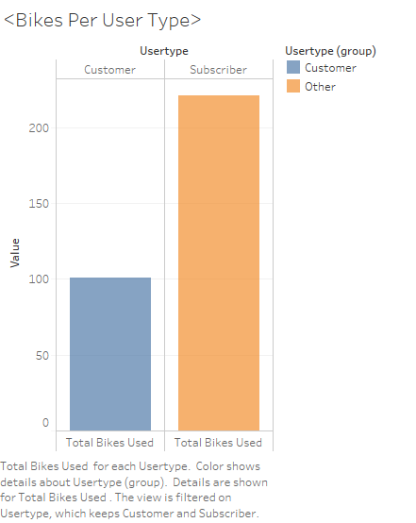

Slide 3


Slide 4
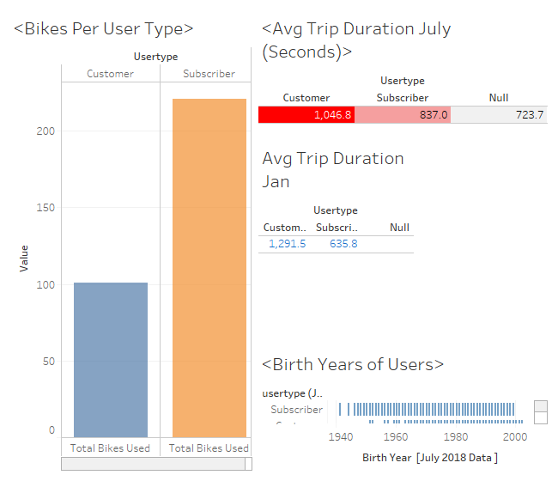

Slide 5
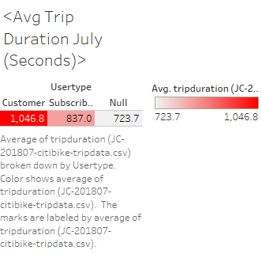

Slide 6
